Slide 1

A vocabulary for economic networks
https://valueflo.ws

Slide 2
Valueflows is a standard vocabulary
Valueflows is a set of common vocabularies to describe flows of economic resources of all kinds within distributed economic ecosystems
Its purpose is to enable inter-networking among many different software applications, used by many different kinds of economic formations
Examples are value networks, supply chains, joint ventures, business collaboration networks…. as well as individual cooperatives and other organizations
Valueflows supports
  Exchange/transfer (mutual credit, marketplace, e-commerce, offer/request matching, gift economy, contribution economy, mutual aid, etc.)
  Production/creation (manufacturing, supply chain, distribution, digital and knowledge works, services, etc.)

Slide 3
Valueflows is based on REA
REA stands for Resources, Events, Agents.
Agents are individual persons or organizations or ecological agents, who perform Economic Events affecting Economic Resources.
An Economic Event can take actions like produce, modify, consume, or use Economic Resources, or transfer them from one Agent to another.
Economic Resources could be
Useful goods and services
Knowledge, designs
Money, alternate currencies, tokens, credits
Labor power, skills
CO2, methane, heat
Air, water, soil microbiota
. . .

Slide 4

Levels of the ontology
The Knowledge level represents classification, policies, procedures, rules and patterns. This is where each network or community can configure the core concepts to fit their needs.
The Plan level represents offers and requests, schedules and promises. This level can also support budgeting or other pre-operational general planning.
The Observation level represents what really happened. This is used for coordinating operations, accounting, other reporting and analysis.

Slide 5

Operations: input-process-output
The first basic pattern for modeling resource flows is input-process-output. When an output from one process becomes an input to another, those processes are connected.
Processes can be defined at whatever level makes sense. For example, having 3 processes in this flow allows operational flexibility: The baker can make a lot of dough and use it for blueberry and pumpkin pie, as well as apple pie. Then she might want to bake different kinds of pies in one oven at the same time too, or freeze half of the unbaked apple pies to bake later.

Slide 6
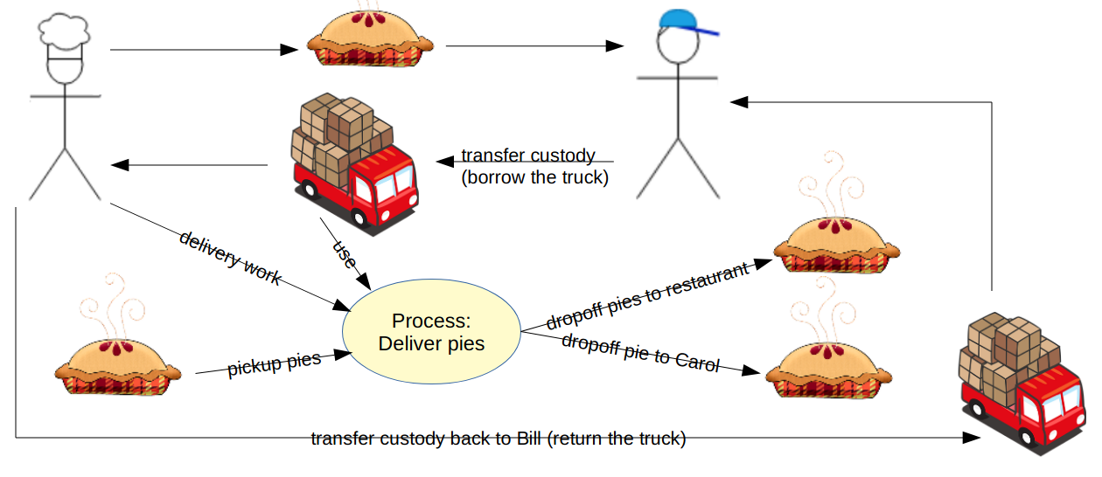
Operations: exchange and distribution
The second basic pattern for modeling resource flows is transfer, where a resource goes from one agent to another, without being changed. If there is another transfer reciprocal to the first, they are an exchange of resources.
transfer
Transfer of resources, transformation and transportation of resources, can all connect into larger resource flows. Resource flows can be of any length, or circular.

Slide 7
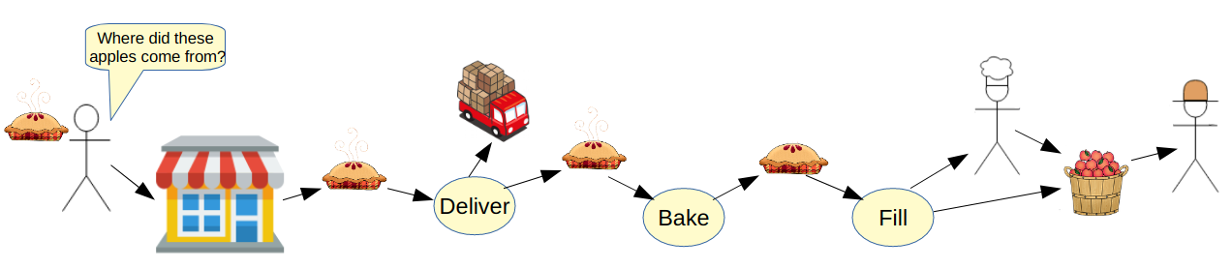
Operations: tracking and tracing
One of the most often used traces is to find the origin(s) of health problems like mad cow disease, and tainted drugs and food; then the flows are tracked forward to find all possible effects from the original problem.
A nicer story: A restaurant customer might find out that the pies are made by a local baker who uses all organic ingredients. They might find out that the apples come from a cooperative worker-owned apple orchard.
More in the future: The European Commission plans to introduce a “digital product passport” that would contain information about the composition of goods on the European market to help boost their chances of being reused and recycled.

Slide 8

Networks of networks

Slide 9
Thank you!
https://valueflo.ws

